Slide 1
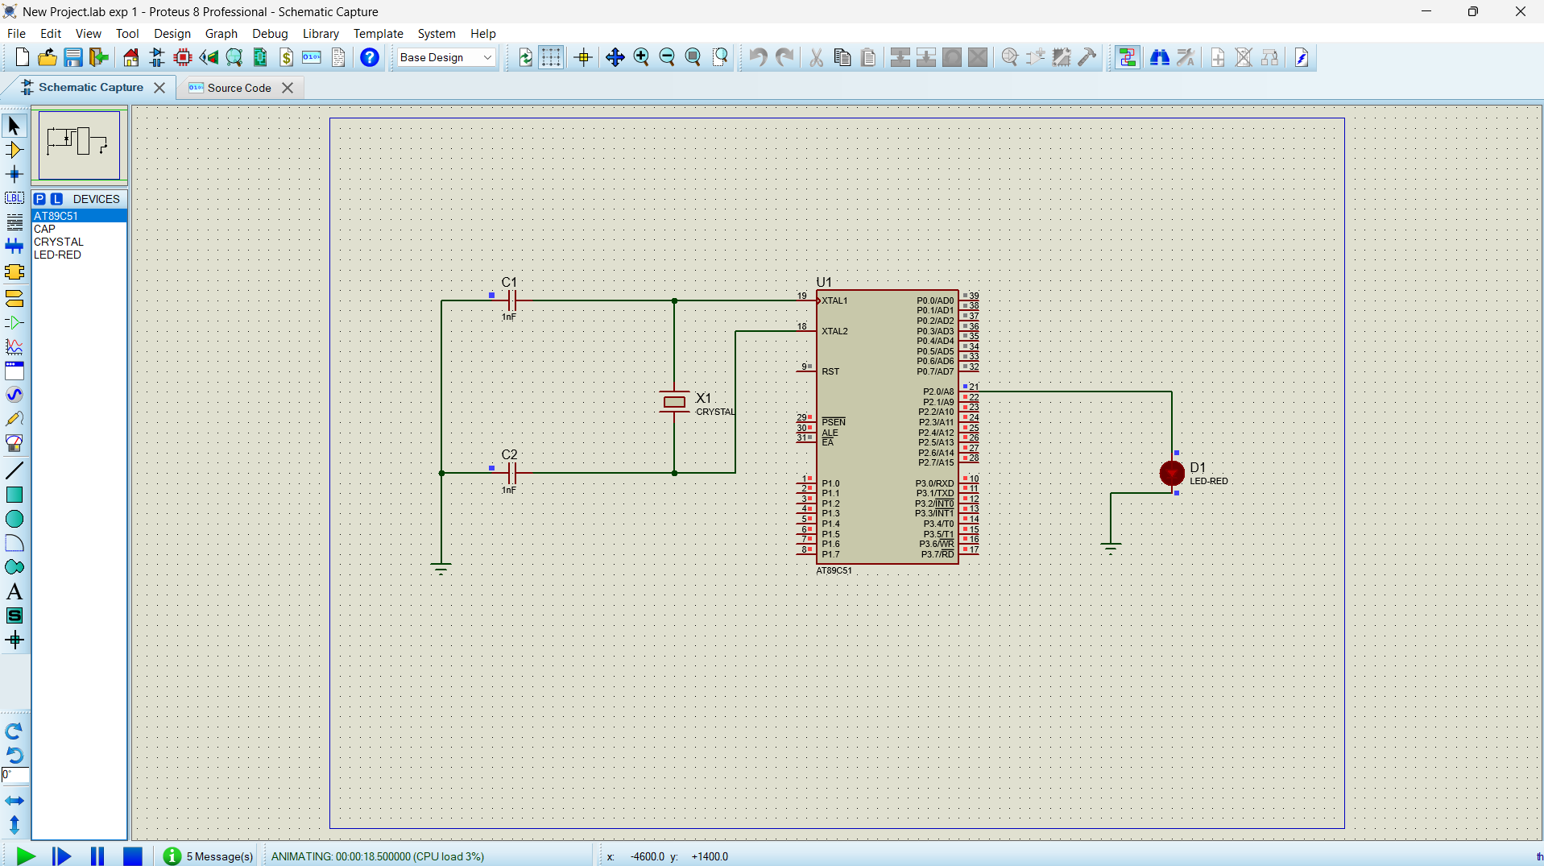
FLASHING OF LED USING AT89C51 MICROCONTROLLER USING PROTEUS
Objectives :-
To study the base operations of AT85C91 microcontroller
To interface an LED with microcontroller
To generate LED blinking using a software delay row
Program :-
ORG 0000H
UP: SETB P2.0
ACALL DELAY
CLR P2.0
ACALL DELAY
SJMP UP
DELAY: MOV R4,#35
H1:MOV R3,#255
H2:DJNZ R3,H2
DJNZ R4,H1
RET
END

